Slide 1
Section 7.1
Decimals

Slide 2
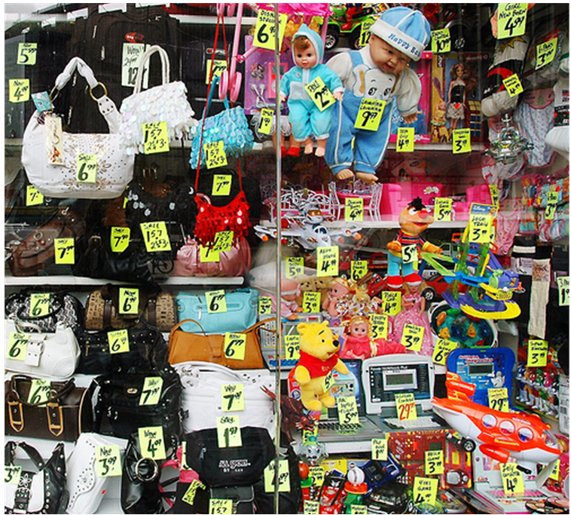
The Use of Decimals in the Real World
A store front display in NYC showing price tags with decimals.

Slide 3
Place Values in a Decimal and the Expanded Form of a Decimal.
Decimals are used to represent fractions in our usual base ten place-value notation. The major difference is that the denominator is not written out; you have to deduce it from context.
3514.726
1000
100
10
1
3
5
1
4
7
2
6
thousands
hundreds
tens
ones
tenths
hundredths
thousandths

Slide 4
Place Values in a Decimal and the Expanded Form of a Decimal.
Given a decimal
5.8147
We can therefore rewrite it in an expanded form
8
1
4
7
5
+
+
+
+
10
100
1000
10000
which can then be converted to a mixed number
8147
5
10000
(expended form thus means showing the denominators.)

Slide 5
Historical Note
The Babylonians did not have specific symbols for fractions, they simply extended their numbers to include fractions in sixtieths.
In other words, they did not show the denominator of the fractions, you need to guess from the context. This is exactly the same as what we do in decimals.
However, the Babylonians did not have a decimal point, and thus it was difficult to distinguish the fractions from the whole number.

Slide 6
In other bases …
42.312_{Five} =
(in base 10)
= 22.656
125
25
5
1
4
2
3
1
2
Twenty-fives
fives
ones
fifths
Twenty-fifths
Hundred-twenty-fives
Hundred-twenty-fifths

Slide 7
Deca- means ten
while
Deci- means tenth

Slide 11
Converting Fractions to Decimals
Theorem:
If the fraction a/b is in its reduced form, then its decimal expansion is terminating if and only if b is one of the following forms.
a product of 2’s only,
a product of 5’s only
a product of 2’s and 5’s only.
Examples:
3
is not terminating
17
is terminating
11
625
21
=
7
=
7
is terminating
1920
640
2
7
5
1

Slide 12
How a decimal is read?
A decimal is read as if they were written in fraction form except that the decimal point is read “and”. We don’t use the word “and” in any other places.
Example: 1204.657 is read as
657
i.e.
1204
1000
“One thousand
two hundred
four
and
six hundred fifty seven
thousandths”
This method works only for short decimals, and when there are many digits after the decimal point, such as 3.1415926, the scientists and engineers will call it
“Three point one four one five nine two six”

Slide 13
How is a decimal read?
A problem for discussion
Is there any chance of confusion when a student reads the decimal 1204.38 as
“One thousand and two hundred and four and thirty eight hundredths” ?
Response
In daily uses, it seldomly causes a problem, but it doesn’t mean that confusion will never happen either. For instance, consider the number
36,800.041
If you read this as
“Thirty six thousand and eight hundred and forty one thousandths”,
then the person who heard this may interpret it as “36,000.841”

Slide 14
Remarks
1. The decimal notation is not unique throughout the world even up to this day.
For example, the British uses 3·1416 (with the dot higher) while the French and German use 3,1416
2. When we change a fraction into a decimal, the representation is not always terminating.
1
=
⋅
⋅
eg.
0
⋅
.
333
3
and we will see later that even terminating decimals have non-terminating representations such as
0.25 = 0.2499999 ….

Slide 15
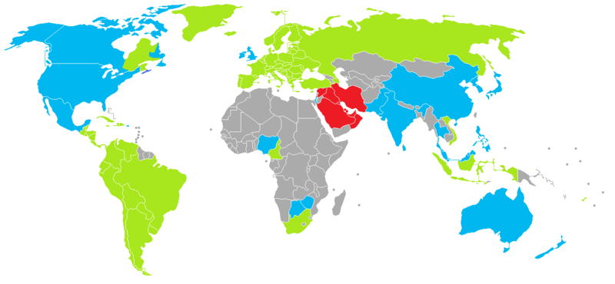
dot
comma
Momayyez
unknown

Slide 16
Comparing Decimals
Research shows that most students believe that
0.287 is bigger than 0.35
because
0.287 has more digits than 0.35
0.287 is read as “two hundred eighty seven thousandths” which sounds larger than “thirty five hundredths”, particularly when they are not familiar with the fact than “one thousandth” is really smaller than “one hundredth”.

Slide 17
Ordering Decimals
Given two decimals, how do we determine quickly which one is larger?
The method is rather easy to learn from just a few examples.
Example
Which one is larger, 6.724 or 6.72189 ?
Solution
We first put one of them above the other such that the decimal points are lined up. (click to see the animation)

Slide 18
Ordering Decimals
Given two decimals, how do we determine quickly which one is larger?
The method is rather easy to learn from just a few examples.
Example
Which one is larger, 6.724 or 6.72189 ?
6.724
Solution
We first put one of them above the other such that the decimal points are lined up.

Slide 19
Ordering Decimals
Given two decimals, how do we determine quickly which one is larger?
The method is rather easy to learn from just a few examples.
Example
Which one is larger, 6.724 or 6.72189 ?
6.72189
Solution
We first put one of them above the other such that the decimal points are lined up.
6.724

Slide 20
Ordering Decimals
Given two decimals, how do we determine quickly which one is larger?
The method is rather easy to learn from just a few examples.
Example
Which one is larger, 6.724 or 6.72189 ?
Solution
We first put one of them above the other such that the decimal points are lined up.
Next we compare the whole number portions – whichever has the larger whole number portion is the bigger decimal.
6.724
6.72189

Slide 21
Ordering Decimals
Given two decimals, how do we determine quickly which one is larger?
The method is rather easy to learn from just a few examples.
Example
Which one is larger, 6.724 or 6.72189 ?
Solution
We first put one of them above the other such that the decimal points are lined up.
Next we compare the whole number portions – whichever has the larger whole number portion is the bigger decimal.
6.724
6.72189
In this case, they are both equal, so we have to compare the digits in the first column on the right of the decimal point.

Slide 22
Ordering Decimals
Given two decimals, how do we determine quickly which one is larger?
The method is rather easy to learn from just a few examples.
Example
Which one is larger, 6.724 or 6.72189 ?
Solution
We first put one of them above the other such that the decimal points are lined up.
Next we compare the whole number portions – whichever has the larger whole number portion is the bigger decimal.
In this case, they are both equal, so we have to compare the digits in the first column on the right of the decimal point.
6.724
6.72189

Slide 23
Ordering Decimals
Given two decimals, how do we determine quickly which one is larger?
The method is rather easy to learn from just a few examples.
Example
Which one is larger, 6.724 or 6.72189 ?
Solution
We first put one of them above the other such that the decimal points are lined up.
Next we compare the whole number portions – whichever has the larger whole number portion is the bigger decimal.
In this case, they are both equal, so we have to compare the digits in the first column on the right of the decimal point.
6.724
6.72189

Slide 24
Ordering Decimals
Given two decimals, how do we determine quickly which one is larger?
The method is rather easy to learn from just a few examples.
Example
Which one is larger, 6.724 or 6.72189 ?
Solution
We first put one of them above the other such that the decimal points are lined up.
In this column, the two digits are also equal, so we have to keep moving to the right until we can find a column that has two different digits.
(Please click to see animation.)
6.724
6.72189

Slide 25
Ordering Decimals
Given two decimals, how do we determine quickly which one is larger?
The method is rather easy to learn from just a few examples.
Example
Which one is larger, 6.724 or 6.72189 ?
Solution
We first put one of them above the other such that the decimal points are lined up.
In this column, the two digits are also equal, so we have to keep moving to the right until we can find a column that has two different digits.
6.724
6.72189

Slide 26
Ordering Decimals
Given two decimals, how do we determine quickly which one is larger?
The method is rather easy to learn from just a few examples.
Example
Which one is larger, 6.724 or 6.72189 ?
Solution
We first put one of them above the other such that the decimal points are lined up.
In this column, the two digits are also equal, so we have to keep moving to the right until we can find a column that has two different digits.
6.724
6.72189
Now we see that the upper digit in the highlighted column is larger, there for the corresponding number (i.e. the upper one) is larger than the lower one.

Slide 27
Multiplying or Dividing Decimals by Powers of 10
Multiplying a decimal by 10^{n} will change the place value of each digit; but will not change the face value of the digits, hence it seems like we just move the decimal point to the right n place.
Example
$$3.7615×{10}^{3}$$
$$=\left(3+\frac{7}{10}+\frac{6}{100}+\frac{1}{1000}+\frac{5}{10,000}\right)×1000$$
$=3000+\frac{7}{10}×1000+\frac{6}{100}×1000+\frac{1}{1000}×1000+$ $\frac{5}{10,000}×1000$
$$=3000+700+60+1+\frac{5}{10}$$
$$=3761.5$$

Slide 28
Multiplying or Dividing Decimals by Powers of 10
Multiplying a decimal by 10^{n} is the same as moving the decimal point to the right n places, adding place holders if necessary.
eg. 3.7615 × 10³
= 3761.5
eg. 743.28 × 10⁵ = 74328000.
Dividing a decimal by 10^{n} is the same as moving the decimal point to the left n places, adding place holders if necessary.
eg. 743.28 ÷ 10² = 7.4328
eg. 3.7615 ÷ 10³ = 0.0037615

